Slide 1
Hidden Markov Models
Most slides come from http://www.inf.ed.ac.uk/teaching/courses/asr/2020-21/asr05-hmm-algorithms.pdf
Ying shen
School of software engineering
Tongji university

Slide 2
Content
Introduction to HMMs: Hidden Markov models
HMM for ASR
Likelihood computation (forward algorithm)
Finding the most probable state sequence (Viterbi algorithm)
Estimating the parameters (forward-backward and EM algorithms)
Notes:
https://www.khanacademy.org/computing/computer-science/informationtheory/moderninfotheory/v/markov_chains

Slide 3
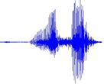


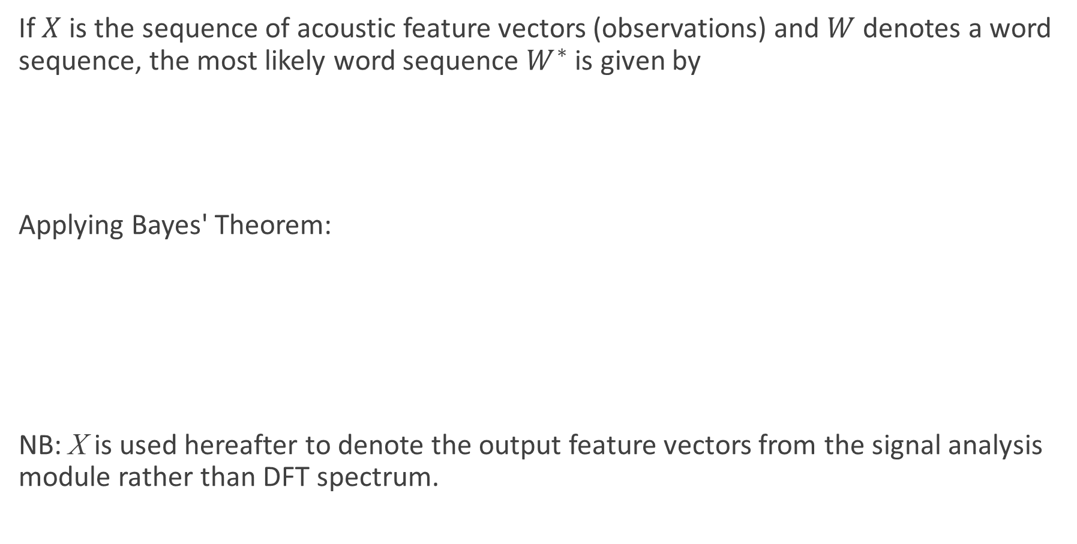

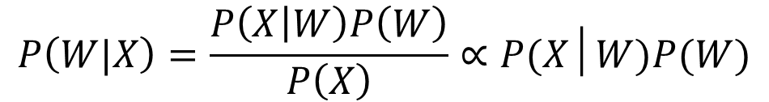

Fundamental Equation of Statistical Speech Recognition
If $X$ is the sequence of acoustic feature vectors (observations) and $W$ denotes a word sequence, the most likely word sequence $W^{∗}$ is given by
Applying Bayes' Theorem:
NB: X is used hereafter to denote the output feature vectors from the signal analysis module rather than DFT spectrum.
$$W^{∗}=\arg{\max_{W}{P\left(W|X\right)}}$$
$$P\left(W|X\right)=\frac{P\left(X | W\right)P\left(W\right)}{P\left(X\right)}∝P(X│W)P(W)$$
$$W^{∗}=\arg{\max_{W}{P\left(X|W\right) P(W)}}$$
Acoustic model
Language model
Speech Recognition
今天天气很好
$$X$$
$$W^{∗}$$

Slide 4
Acoustic Modelling
Decoded Text
(Transcription)
Recorded Speech
Hidden Markov model
Signal Analysis
Acoustic Model
Search Space
Language Model
Training Data

Slide 5









Hierarchical modelling of speech
今天天气很好
语言模型
$$P\left(W\right)$$
—N-gram
词序列
今天
天气
很
好
j
in1
t
ian1
t
ian1
q
i4
h
en3
h
ao3
音素序列
声学模型
$$P\left(O | W\right)$$
—HMM
状态序列
$$s1$$
$$s2$$
$$s3$$
$$s4$$
$$s5$$
特征序列
$$O$$
……
时间$t$

Slide 6






Hierarchical modelling of speech
今天天气很好
今天
天气
很
好
j
in1
t
ian1
t
ian1
q
i4
h
en3
h
ao3
$$s_{1}$$
$$s_{2}$$
$$s_{3}$$
…
$$s_{1}$$
$$s_{2}$$
$$s_{3}$$

Slide 7
Content
Introduction to HMMs: Hidden Markov models
HMM for ASR
Likelihood computation (forward algorithm)
Finding the most probable state sequence (Viterbi algorithm)
Estimating the parameters (forward-backward and EM algorithms)

Slide 8
The Hidden Markov Model
A statistical model for time series data with a set of discrete states (1,…, J) (we index them by j or k)
At each time step t:
the model is in a fixed state q_{t} .
the model generates an observation, x_{t} , according to a probability distribution that is specific to the state
We don’t actually observe which state the model is in at each time step -- hence “hidden”
Observations can be either continuous or discrete (usually the former)

Slide 9







HMM probabilities
Imagine we know the state at a given time step $t$, $q_{t}=k$
Then the probability of being in a new state, $j$ at the next time step, is dependent only on $q_{t}$ . This is the Markov assumption.
Alternatively: $q_{t+1}$ is conditionally independent of $q_{1}, . . . , q_{t−1}$, given $q_{t}$
$$q_{t−1}$$
$$q_{t}$$
$$q_{t+1}$$
$$x_{t−1}$$
$$x_{t}$$
$$x_{t−1}$$

Slide 10






HMM assumptions
Note that observation independence is an assumption that naturally arises from the model: the probability of $x_{t}$ depends only on the state that generated it, $q_{t}$ .
$$p(q_{t}|q_{t−1})$$
$$p(q_{t+1}|q_{t})$$
$$q_{t−1}$$
$$q_{t}$$
$$q_{t+1}$$
$$p(x_{t}|q_{t−1})$$
$$p(x_{t}|q_{t})$$
$$p(x_{t+1}|q_{t+1})$$
$$x_{t−1}$$
$$x_{t}$$
$$x_{t−1}$$

Slide 11
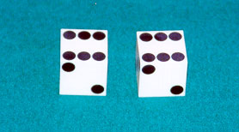
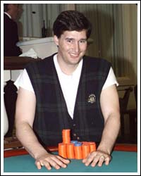
HMM
Example: The dishonest casino
A casino has two dice:
Fair die
P(1) = P(2) = P(3) = P(4) = P(5) = P(6) = 1/6
Loaded die
P(1) = P(2) = P(3) = P(4) = P(5) = 1/10
P(6) = 1/2
Casino player switches between fair and loaded die with probability 1/20 at each turn

Slide 12
HMM
Game
You bet $1
You roll (always with a fair die)
Casino player rolls (maybe with fair die, maybe with loaded die)
Highest number wins $2

Slide 13
Question # 1 – Decoding
GIVEN
A sequence of rolls by the casino player
QUESTION
What portion of the sequence was generated with the fair die, and what portion with the loaded die?
This is the DECODING question in HMMs
1245526462146146136136661664661636616366163616515615115146123562344
FAIR
LOADED
FAIR

Slide 14
Question # 2 – Likelihood
GIVEN
A sequence of rolls by the casino player
QUESTION
How likely is this sequence, given our model of how the casino works?
This is the LIKELIHOOD problem in HMMs
1245526462146146136136661664661636616366163616515615115146123562344
Prob = 1.3 x 10⁻³⁵

Slide 15
Question # 3 – Training
GIVEN
A sequence of rolls by the casino player
QUESTION
How “loaded” is the loaded die? How “fair” is the fair die? How often does the casino player change from fair to loaded, and back?
This is the TRAINING question in HMMs
1245526462146146136136661664661636616366163616515615115146123562344
Prob(6) = 64%

Slide 16
The dishonest casino model
0.05
0.95
0.95
FAIR
LOADED
0.05
P(1|F) = 1/6
P(2|F) = 1/6
P(3|F) = 1/6
P(4|F) = 1/6
P(5|F) = 1/6
P(6|F) = 1/6
P(1|L) = 1/10
P(2|L) = 1/10
P(3|L) = 1/10
P(4|L) = 1/10
P(5|L) = 1/10
P(6|L) = 1/2

Slide 17
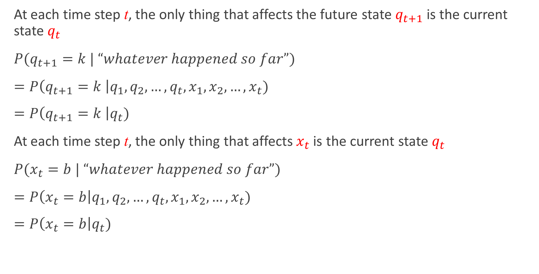
An HMM is memoryless
At each time step t, the only thing that affects the future state $q_{t+1}$is the current state $q_{t}$
$P(q_{t+1}=k | “whatever happened so far”)$
$=P\left(q_{t+1}=k \right|q_{1}, q_{2},…,q_{t},x_{1}, x_{2}, …, x_{t})$
$=P\left(q_{t+1}=k \right|q_{t})$
At each time step t, the only thing that affects $x_{t}$ is the current state $q_{t}$
$P(x_{t}=b | “whatever happened so far”)$
$=P\left(x_{t}=b\right|q_{1}, q_{2},…,q_{t},x_{1}, x_{2}, …, x_{t})$
$=P\left(x_{t}=b\right|q_{t})$
1
2
K
…

Slide 18
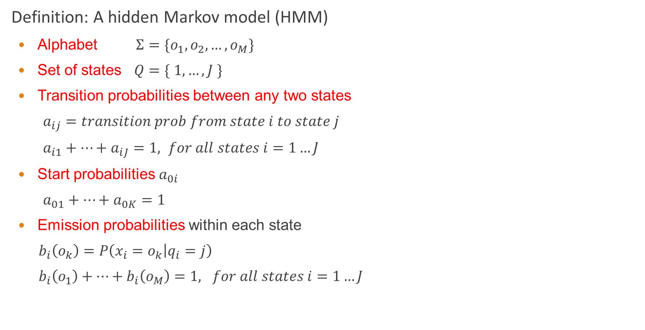
Definition of HMM
Definition: A hidden Markov model (HMM)
Alphabet $Σ=\{o_{1}, o_{2}, …, o_{M}\}$
Set of states $Q=\{ 1, …, J \}$
Transition probabilities between any two states
$a_{ij}=transition prob from state i to state j$
$a_{i1}+…+a_{iJ}=1, for all states i=1…J$
Start probabilities $a_{0i}$
$a_{01}+…+a_{0K}=1$
Emission probabilities within each state
$b_{i}\left(o_{k}\right)=P\left(x_{i}=o_{k} | q_{i}=j\right)$
$b_{i}\left(o_{1}\right)+…+b_{i}\left(o_{M}\right)=1, for all states i=1…J$
1
2
K
…

Slide 19





A parse of a sequence
Given a sequence $x=x_{1}…x_{N}$,
A parse of x is a sequence of states $Q=q_{1},…,q_{N}$
1
1
1
1
…
1
2
2
2
2
2
…
2
…
…
…
…
K
K
K
K
…
K
$$x_{1}$$
$$x_{2}$$
$$x_{3}$$
$$x_{N}$$

Slide 20







Generating a sequence by the model
Given a HMM, we can generate a sequence of length N as follows:
Start at state $q_{1}$ according to prob $a_{0q_{1}}$
Emit letter $x_{1}$ according to prob $b_{q_{1}}(x_{1})$
Go to state $q_{2}$ according to prob $a_{q_{1}q_{2}}$
… until emitting $x_{N}$
1
1
1
1
…
1
$$a02$$
2
2
2
2
2
…
2
0
…
…
…
…
K
K
K
K
…
K
$$b2(x1)$$
$$x_{1}$$
$$x_{2}$$
$$x_{3}$$
$$x_{N}$$

Slide 21

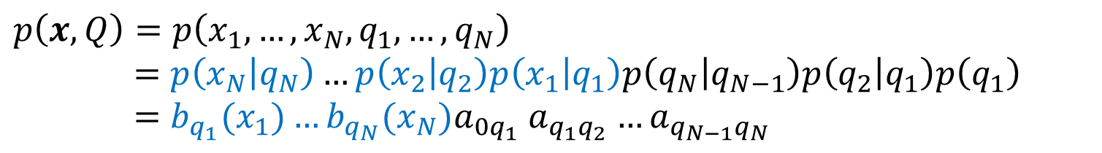




Likelihood of a parse
Given a sequence $x=x_{1}…x_{N}$ and a parse $Q=q_{1},…q_{N}$,
To find how likely this scenario is: (given our HMM)
$$p\left(x, Q\right)=p\left(x_{1}, …, x_{N}, q_{1}, …, q_{N}\right)$$
$$=p\left(x_{N} | q_{N}\right)…p\left(x_{2} | q_{2}\right)p\left(x_{1} | q_{1}\right)p\left(q_{N} | q_{N−1}\right)p\left(q_{2} | q_{1}\right)p\left(q_{1}\right)$$
$$=b_{q_{1}}(x_{1})…b_{q_{N}}(x_{N})a_{0q_{1}} a_{q_{1}q_{2}}…a_{q_{N−1}q_{N}}$$
1
1
1
1
…
1
2
2
2
2
2
…
2
…
…
…
…
K
K
K
K
K
…
$$x_{1}$$
$$x_{2}$$
$$x_{3}$$
$$x_{N}$$

Slide 22
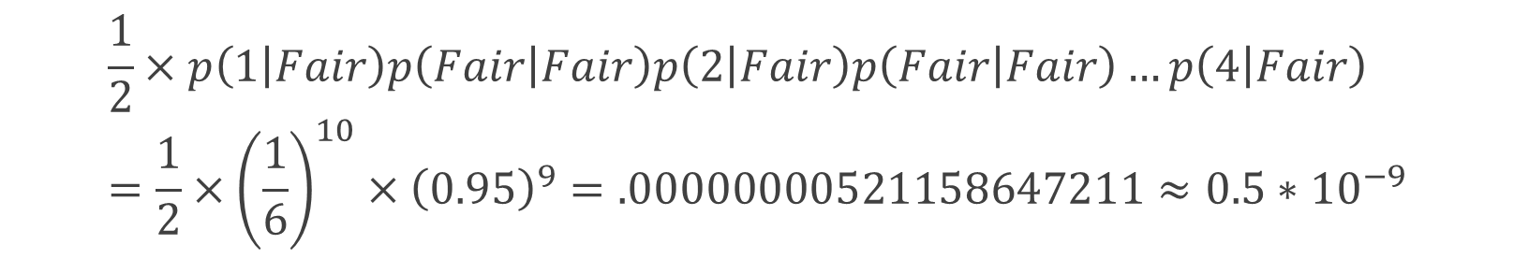
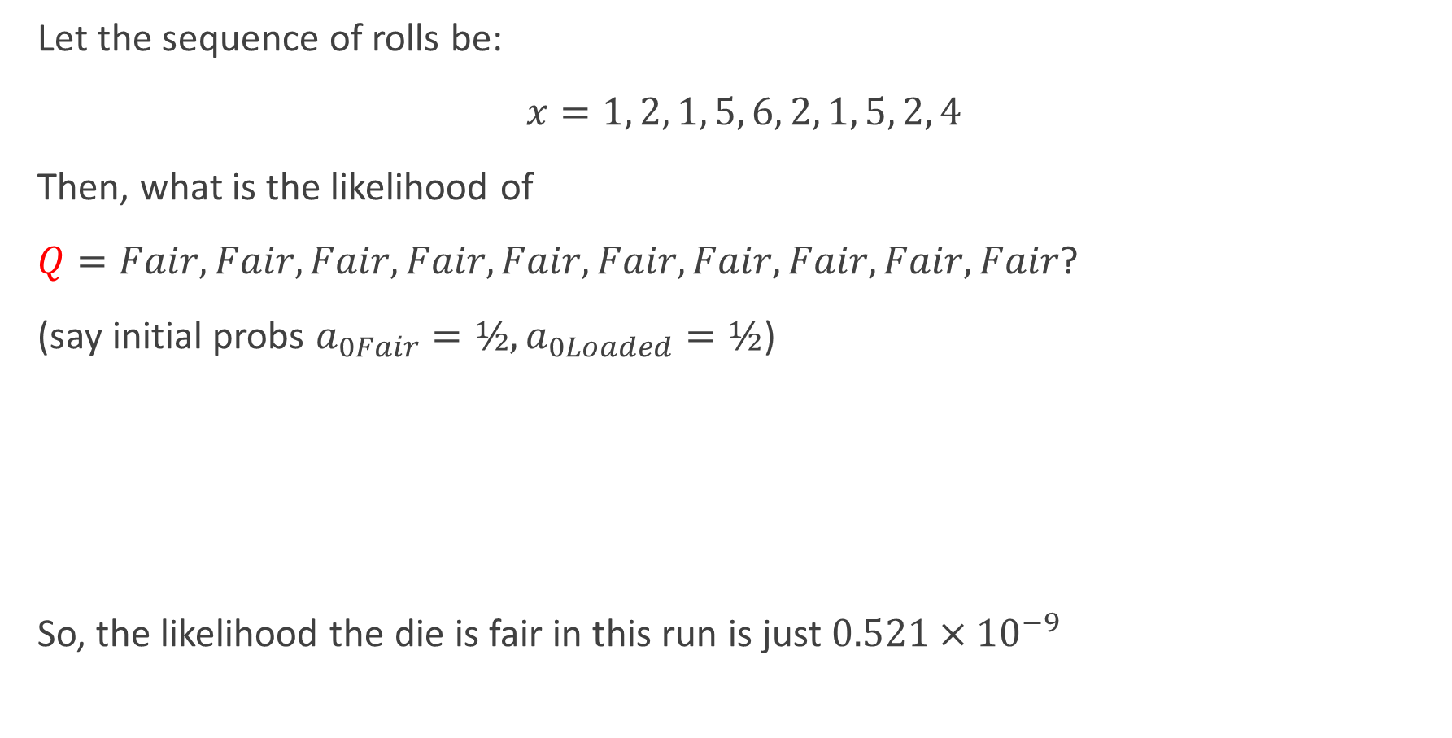
Example: the dishonest casino
Let the sequence of rolls be:
$x=1, 2, 1, 5, 6, 2, 1, 5, 2, 4$
Then, what is the likelihood of
$Q=Fair, Fair, Fair, Fair, Fair, Fair, Fair, Fair, Fair, Fair$?
(say initial probs $a_{0Fair}=½, a_{0Loaded}=½$)
So, the likelihood the die is fair in this run is just $0.521×{10}^{−9}$
$$\frac{1}{2}×p\left(1 | Fair\right)p\left(Fair | Fair\right)p\left(2 | Fair\right)p\left(Fair | Fair\right)…p\left(4 | Fair\right)=\frac{1}{2}×{\left(\frac{1}{6}\right)}^{10}×{\left(0.95\right)}^{9}=.00000000521158647211≈0.5∗{10}^{−9}$$

Slide 23
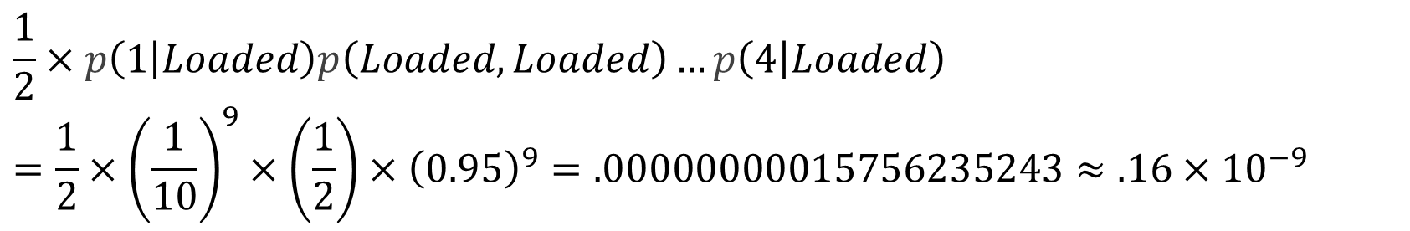
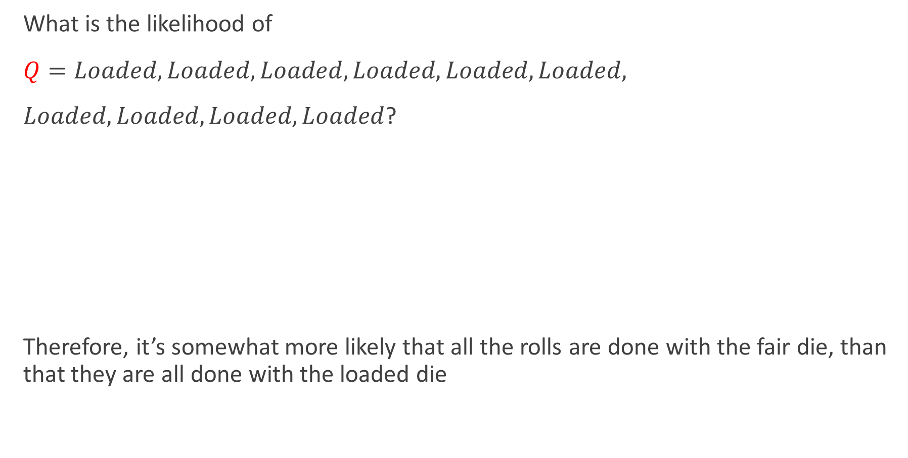
Example: the dishonest casino
What is the likelihood of
$Q=Loaded, Loaded, Loaded, Loaded, Loaded, Loaded,$
$Loaded, Loaded, Loaded, Loaded$?
Therefore, it’s somewhat more likely that all the rolls are done with the fair die, than that they are all done with the loaded die
$$\frac{1}{2}×p\left(1 | Loaded\right)p\left(Loaded, Loaded\right)…p\left(4 | Loaded\right)$$
$$=\frac{1}{2}×{\left(\frac{1}{10}\right)}^{9}×\left(\frac{1}{2}\right)×{\left(0.95\right)}^{9}=.00000000015756235243≈.16×{10}^{−9}$$

Slide 24

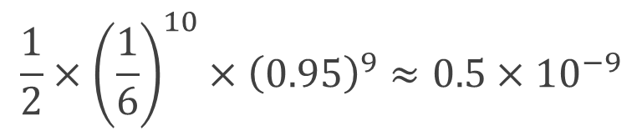
Example: the dishonest casino
Let the sequence of rolls be:
$x=1, 6, 6, 5, 6, 2, 6, 6, 3, 6$
Now, what is the likelihood $π=F, F, …, F$?
same as before
What is the likelihood $Q=L, L, …, L$?
So, it is 100 times more likely the die is loaded
$$\frac{1}{2}×{\left(\frac{1}{6}\right)}^{10}×{\left(0.95\right)}^{9}≈0.5×{10}^{−9}$$
$$\frac{1}{2}×{\left(\frac{1}{10}\right)}^{4}×{\left(\frac{1}{2}\right)}^{6}×{\left(0.95\right)}^{9}=.00000049238235134735≈0.5×{10}^{−7}$$

Slide 25
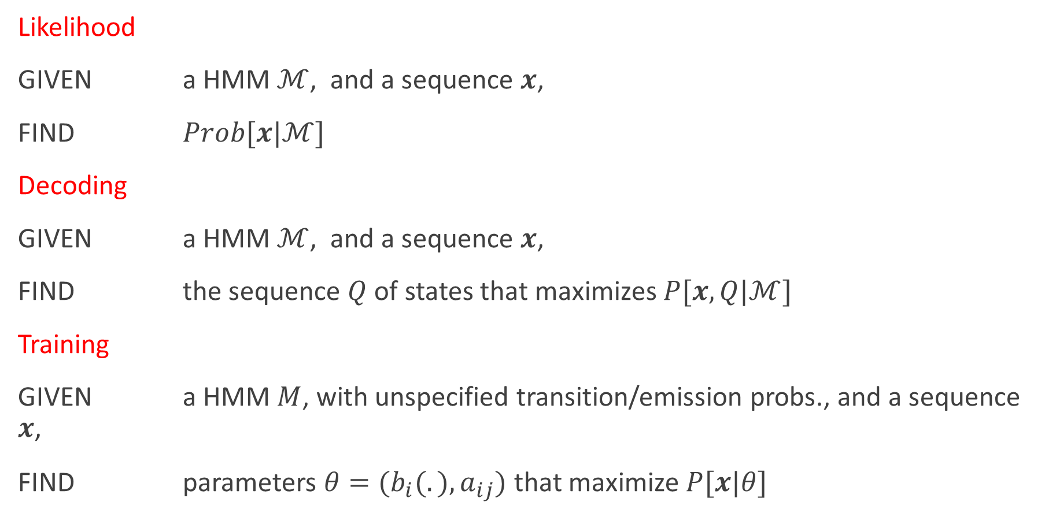
The three main questions on HMMs
Likelihood
GIVEN a HMM $ℳ$, and a sequence $x$,
FIND $Prob[x|ℳ]$
Decoding
GIVEN a HMM $ℳ$, and a sequence $x$,
FIND the sequence $Q$ of states that maximizes $P[x, Q|ℳ]$
Training
GIVEN a HMM $M$, with unspecified transition/emission probs., and a sequence $x$,
FIND parameters $θ=(b_{i}(.), a_{ij})$that maximize $P[x|θ]$

Slide 26



















HMM topologies
The HMM topology determines the set of allowed transitions between states
In principle any topology is possible
$$a_{33}$$
$$a_{11}$$
$$a_{12}$$
$$a_{23}$$
$$2$$
$$1$$
$$3$$
$$a_{14}$$
$$a_{43}$$
$$a_{15}$$
$$4$$
$$a_{37}$$
$$a_{71}$$
$$5$$
$$a_{56}$$
$$a_{67}$$
$$7$$
$$6$$
$$a_{76}$$

Slide 27



Example topologies
Speech recognition: left-to-right HMM with 3~5 states
Speaker recognition: ergodic HMM
left−to−right model
parallel path left−to−right model
ergodic model
$$\left(\begin{matrix}a_{11} & a_{12} & \begin{matrix}a_{13} & 0 & 0\end{matrix} \\ 0 & a_{22} & \begin{matrix}a_{23} & a_{24} & 0\end{matrix} \\ 0 & 0 & \begin{matrix}a_{33} & a_{34} & a_{35}\end{matrix} \\ 0 & 0 & \begin{matrix} 0 & a_{44} & a_{45}\end{matrix} \\ 0 & 0 & \begin{matrix}0 & 0 & a_{55}\end{matrix}\end{matrix}\right)$$
$$\left(\begin{matrix}a_{11} & a_{12} & 0 \\ 0 & a_{22} & a_{23} \\ 0 & 0 & a_{33}\end{matrix}\right)$$
$$\left(\begin{matrix}a_{11} & a_{12} & \begin{matrix}a_{13} & a_{14}\end{matrix} \\ a_{21} & a_{22} & \begin{matrix}a_{23} & a_{24}\end{matrix} \\ a_{31} & a_{23} & \begin{matrix}a_{33} & a_{34}\end{matrix} \\ a_{41} & a_{42} & \begin{matrix}a_{43} & a_{44}\end{matrix}\end{matrix}\right)$$

Slide 28
HMMs for ASR
We generally model words or phones with a left-to-right topology with self loops.
r
ai
t

Slide 29
HMMs for ASR
Traditional HMMs for ASR tend to model each phone with three distinct states (this also enforces a minimum phone duration of three frames of observations)
r1
r2
r3
ai1
ai2
ai3
t1
t2
t3

Slide 30
HMMs for ASR
Traditional HMMs for ASR tend to model each phone with three distinct states (this also enforces a minimum phone duration of three frames of observations)
The phone model topologies can be concatenated to form a HMM for the whole word
r1
r2
r3
ai1
ai2
ai3
t1
t2
t3

Slide 31



HMMs for ASR
Traditional HMMs for ASR tend to model each phone with three distinct states (this also enforces a minimum phone duration of three frames of observations)
This model naturally generates an alignment between states and observations (and hence words/phones).
r1
r2
r3
ai1
ai2
ai3
t1
t2
t3
…..
$$x_{1}$$
$$x_{2}$$
$$x_{3}$$
…..

Slide 32
Content
Introduction to HMMs: Hidden Markov models
HMM for ASR
Likelihood computation (forward algorithm)
Finding the most probable state sequence (Viterbi algorithm)
Estimating the parameters (forward-backward and EM algorithms)

Slide 33
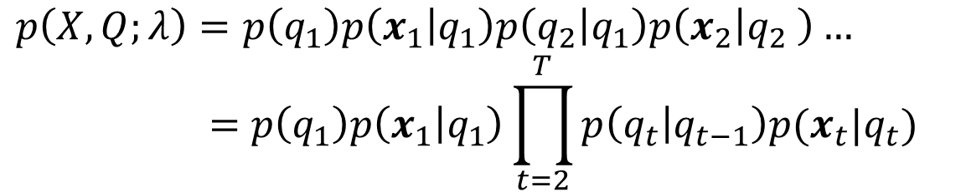
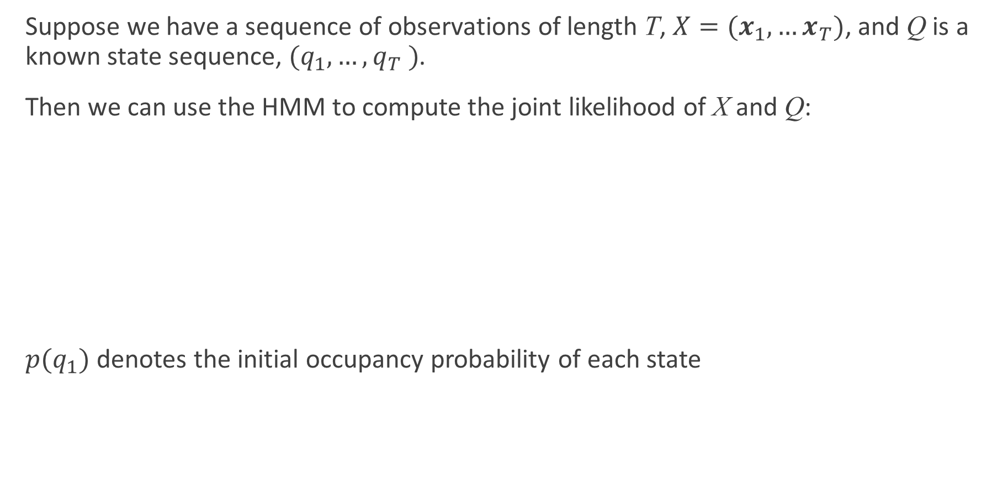
Computing likelihoods with the HMM
Suppose we have a sequence of observations of length T, $X=(x_{1},…x_{T})$, and Q is a known state sequence, $(q_{1},…,q_{T} )$.
Then we can use the HMM to compute the joint likelihood of X and Q:
$p(q_{1})$ denotes the initial occupancy probability of each state
$$p\left(X,Q;λ\right)=p\left(q_{1}\right)p\left(x_{1} | q_{1}\right)p\left(q_{2} | q_{1}\right)p\left(x_{2} | q_{2} \right)…$$
$$=p\left(q_{1}\right)p\left(x_{1} | q_{1}\right)\prod_{t=2}^{T}{p\left(q_{t} | q_{t−1}\right)p(x_{t}|q_{t})}$$

Slide 34

HMM parameters
The parameters of the model, $λ$, are given by:
Transition probabilities $a_{kj}=p\left(q_{t+1}=j\right|q_{t}=k)$
Observation probabilities $b_{j} (x)=p(x|q=j)$

Slide 35

The three problems of HMMs
Working with HMMs requires the solution of three problems:
Likelihood Determine the overall likelihood of an observation sequence $X=(x_{1}, …, x_{t} , …, x_{T})$ being generated by a known HMM topology, $ℳ$.
Decoding and alignment Given an observation sequence and an HMM, determine the most probable hidden state sequence
Training Given an observation sequence and an HMM, find the state occupation probabilities

Slide 36

Computing likelihood
Working with HMMs requires the solution of three problems:
Likelihood Determine the overall likelihood of an observation sequence $X=(x_{1}, …, x_{t} , …, x_{T})$ being generated by a known HMM topology, $ℳ$.
→ the forward algorithm
NB. We do not know the state sequence!

Slide 37

Notes on the HMM topology
By the HMM topology, $ℳ$, we can mean:
A restricted left-to-right topology based on a known word/sentence, leading to a “trellis-like” structure over time
A much less restricted topology based on a grammar or language model – or something in between
Some algorithms are not (generally) suitable for unrestricted topologies

Slide 38












Example: trellis for a 3-state phone HMM
state
$$E$$
$$r_{1}$$
$$r_{2}$$
$$r_{3}$$
$$I$$
time
$$x_{1}$$
$$x_{2}$$
$$x_{3}$$
$$x_{4}$$
$$x_{5}$$
$$x_{6}$$
$$x_{7}$$

Slide 39



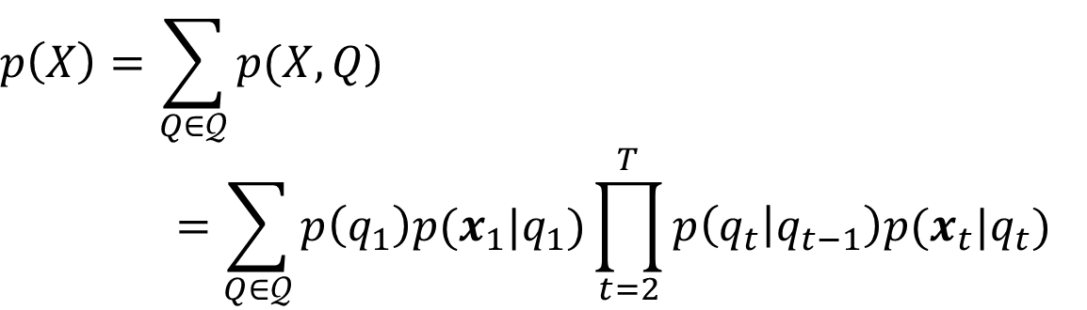













Likelihood
Goal: determine $p(X)$
Sum over all possible state sequences $Q=(q_{1}, …, q_{T})$ that could result in the observation sequence $X$
$$p\left(X\right)=\sum_{Q∈𝒬}{p(X,Q)}$$
$$=\sum_{Q∈𝒬}{p\left(q_{1}\right)p(x_{1}|q_{1})\prod_{t=2}^{T}{p\left(q_{t} | q_{t−1}\right)p(x_{t}|q_{t})}}$$
$$p(q_{2}|q_{1})$$
$$p(q_{3}|q_{2})$$
$$p(q_{T−1}|q_{T})$$
$$q_{1}$$
$$q_{2}$$
…
$$q_{T−1}$$
$$q_{T}$$
$$p(x_{1}|q_{1})$$
$$p(x_{2}|q_{2})$$
$$p(x_{T−1}|q_{T−1})$$
$$p(x_{T}|q_{T})$$
$$x_{1}$$
$$x_{2}$$
$$x_{T−1}$$
$$x_{T}$$

Slide 40


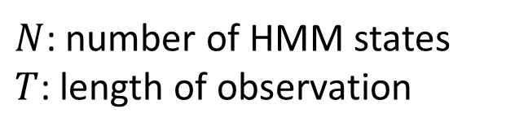
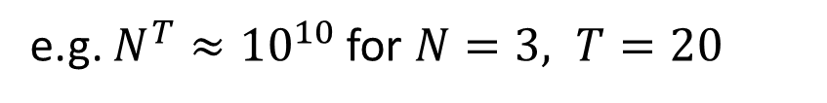
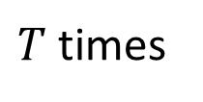
Likelihood
Goal: determine $p(X)$
Sum over all possible state sequences $Q=(q_{1}, …, q_{T})$ that could result in the observation sequence $X$
How many paths Q do we have to calculate?
Computation complexity of multiplication: $O(2TN^{T})$
$$p\left(X\right)=\sum_{Q∈𝒬}{p(X,Q)}$$
$$=\sum_{Q∈𝒬}{p\left(q_{1}\right)p(x_{1}|q_{1})\prod_{t=2}^{T}{p\left(q_{t} | q_{t−1}\right)p(x_{t}|q_{t})}}$$
$$\sim N×N×…×N=N^{T}$$
$N$: number of HMM states
$T$: length of observation
$T$ times
e.g. $N^{T}≈{10}^{10}$ for $N=3, T=20$

Slide 41

Likelihood
Goal: determine $p(X)$
Sum over all possible state sequences $Q=(q_{1}, …, q_{T})$ that could result in the observation sequence $X$
Instead: $p\left(X\right)=\sum_{j=1}^{J}{p(X_{T},q_{T}=j)}=\sum_{j=1}^{J}{α_{T}^{j}}$
$α_{T}^{j}$: the probability of observed sequence $X_{T}=[x_{1},x_{2},…,x_{T}]$ at time $T$ in state $j$
$$p\left(X\right)=\sum_{Q∈𝒬}{p(X,Q)}$$
$$=\sum_{Q∈𝒬}{p\left(q_{1}\right)p(x_{1}|q_{1})\prod_{t=2}^{T}{p\left(q_{t} | q_{t−1}\right)p(x_{t}|q_{t})}}$$

Slide 42
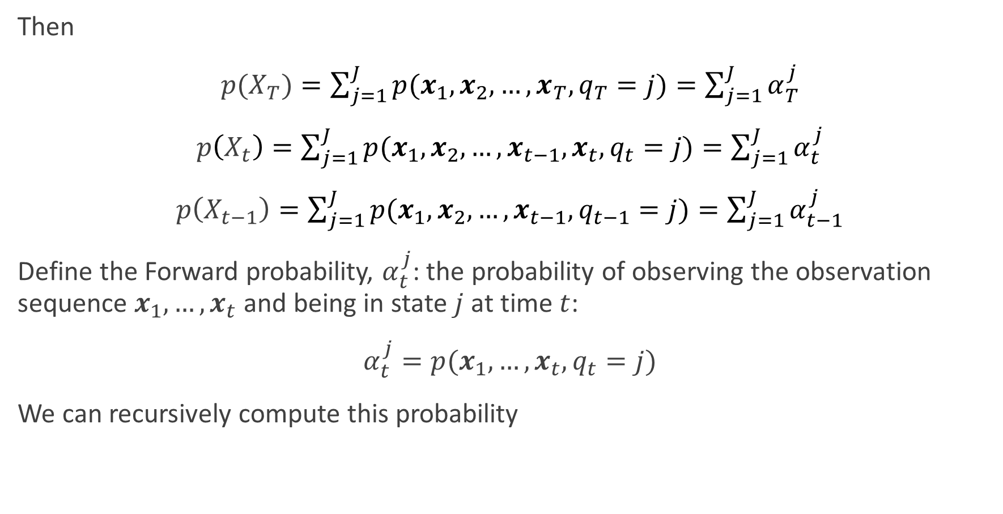
The forward probability
Then
$p(X_{T})=\sum_{j=1}^{J}{p(x_{1},x_{2},…,x_{T},q_{T}=j)}=\sum_{j=1}^{J}{α_{T}^{j}}$
$p\left(X_{t}\right)=\sum_{j=1}^{J}{p(x_{1},x_{2},…,x_{t−1},x_{t},q_{t}=j)}=\sum_{j=1}^{J}{α_{t}^{j}}$
$p\left(X_{t−1}\right)=\sum_{j=1}^{J}{p(x_{1},x_{2},…,x_{t−1},q_{t−1}=j)}=\sum_{j=1}^{J}{α_{t−1}^{j}}$
Define the Forward probability, $α_{t}^{j}$: the probability of observing the observation sequence $x_{1},…,x_{t}$ and being in state $j$ at time $t$:
$α_{t}^{j}=p(x_{1},…,x_{t},q_{t}=j)$
We can recursively compute this probability

Slide 43

Likelihood: The Forward algorithm
The Forward algorithm:
Rather than enumerating each sequence, compute the probabilities recursively (exploiting the Markov assumption)
Reduces the computational complexity to $O(TN^{2})$
Visualize the problem as a state-time trellis
t-1
t
t+1
i
i
i
j
j
j
k
k
k
Notes:
https://www.cs.cmu.edu/~aarti/Class/10701/slides/Lecture17.pdf

Slide 44

Likelihood: The Forward algorithm
Compute $α_{t}^{j}$ for all state $j$, time $t$ using dynamic programming:
Initialization $α_{1}^{j}=p\left(x_{1} | q_{1}=j\right)p(q_{1}=j)$
Iteration
$α_{t}^{j}=p\left(x_{t} | q_{t}=j\right)\sum_{i=1}^{J}{(α_{t−1}^{i}⋅p(q_{t}=j|q_{t−1}=i))},1≤j≤J,1≤t≤T$
Termination $p\left(X\right)=\sum_{j=1}^{J}{α_{T}^{j}}$

Slide 45





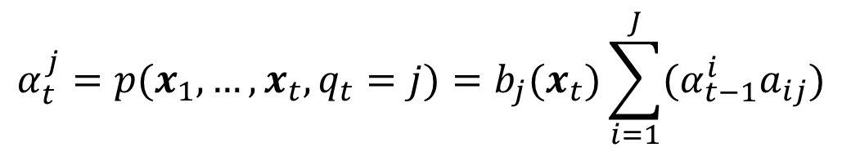









Likelihood: The Forward algorithm
$$α_{t}^{j}=p(x_{1},…,x_{t},q_{t}=j)=b_{j}(x_{t})\sum_{i=1}^{J}{(α_{t−1}^{i}a_{ij})}$$
t-1
t
t+1
i
i
i
$$α_{t−1}^{i}$$
$$a_{ij}$$
$$α_{t}^{i}$$
$$∑$$
j
$$a_{jj}$$
j
j
$$α_{t−1}^{j}$$
$$α_{t}^{j}$$
$$a_{kj}$$
k
k
k
$$α_{t−1}^{k}$$
$$α_{t}^{k}$$
$$b_{j}(x_{t})$$
$$x_{t−1}$$
$$x_{t}$$
$$x_{t+1}$$

Slide 46
Content
Introduction to HMMs: Hidden Markov models
HMM for ASR
Likelihood computation (forward algorithm)
Finding the most probable state sequence (Viterbi algorithm)
Estimating the parameters (forward-backward and EM algorithms)

Slide 47

The three problems of HMMs
Working with HMMs requires the solution of three problems:
Likelihood Determine the overall likelihood of an observation sequence $X=(x_{1}, …, x_{t} , …, x_{T})$ being generated by a known HMM topology, $ℳ$.
→ the forward algorithm
Decoding and alignment Given an observation sequence and an HMM, determine the most probable hidden state sequence
→ the Viterbi algorithm

Slide 48


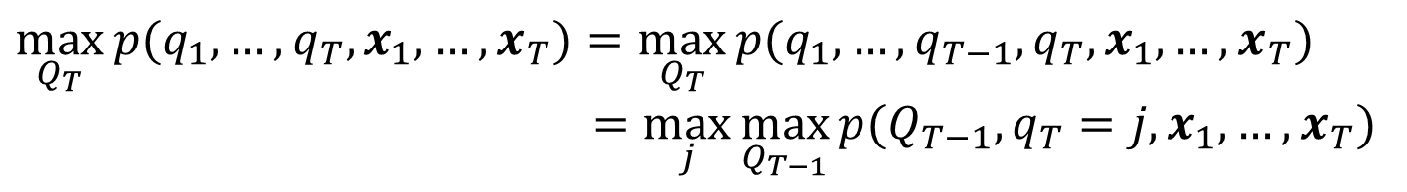
Decoding and alignment
Goal: Find the most likely probable hidden state sequence $Q^{∗}=(q_{1}^{∗}, …, q_{T}^{∗})$given an observation sequence $X$
Similar to the likelihood problem,
$V_{T}^{j}$ -- probability of most likely sequence of states ending at state $q_{T}=j$
$$\arg{\max_{Q}{p\left(Q | X\right)=}}\arg{\max_{Q_{T}}{p(Q_{T},X)}}=\arg{\max_{Q_{T}}{p(q_{1},…,q_{T},x_{1},…,x_{T})}}$$
$$\max_{Q_{T}}{p(q_{1},…,q_{T},x_{1},…,x_{T})}=\max_{Q_{T}}{p(q_{1},…,q_{T−1},q_{T},x_{1},…,x_{T})}$$
$$=\max_{j}{\max_{Q_{T−1}}{p(Q_{T−1},q_{T}=j,x_{1},…,x_{T})}}$$
$$V_{T}^{j}$$
Compute recursively
Notes:
How do we find the most likely state history, or state trajectory? (As opposed to the sequence of point-wise most likely states?)

Slide 49
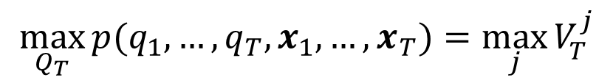

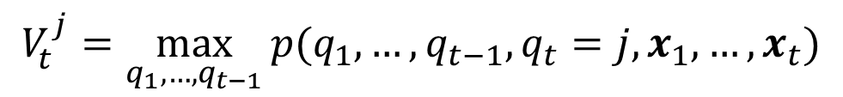
Viterbi decoding
Compute probability $V_{t}^{j}$recursively over $t$
$$\max_{Q_{T}}{p(q_{1},…,q_{T},x_{1},…,x_{T})}=\max_{j}{V_{T}^{j}}$$
$$V_{t}^{j}=\max_{q_{1},…,q_{t−1}}{p(q_{1},…,q_{t−1},q_{t}=j,x_{1},…,x_{t})}$$
$$V_{t−1}^{i}=\max_{q_{1},…,q_{t−2}}{p(q_{1},…,q_{t−2},q_{t−1}=i,x_{1},…,x_{t−1})}$$

Slide 50
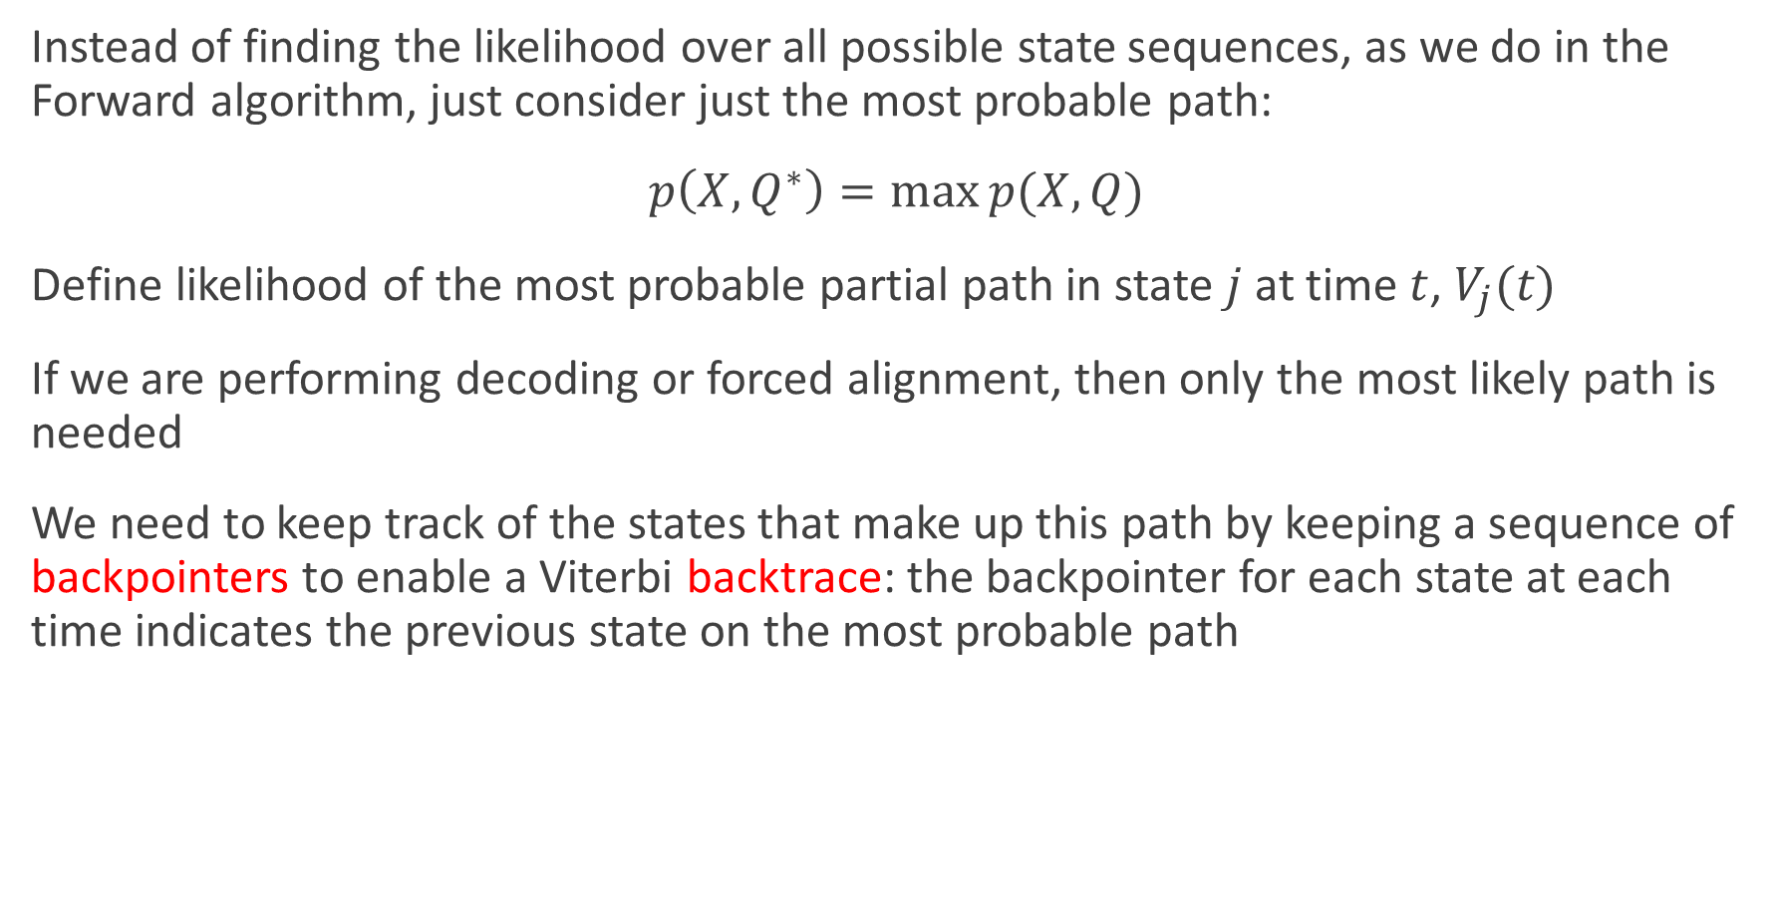
Viterbi algorithm
Instead of finding the likelihood over all possible state sequences, as we do in the Forward algorithm, just consider just the most probable path:
$p\left(X,Q^{∗}\right)=\max{p(X,Q)}$
Define likelihood of the most probable partial path in state $j$ at time $t$, $V_{j}(t)$
If we are performing decoding or forced alignment, then only the most likely path is needed
We need to keep track of the states that make up this path by keeping a sequence of backpointers to enable a Viterbi backtrace: the backpointer for each state at each time indicates the previous state on the most probable path

Slide 51




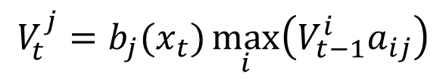

Viterbi recursion
$$V_{t}^{j}=b_{j}(x_{t})\max_{i}\left(V_{t−1}^{i}a_{ij}\right)$$
t-1
t
t+1
i
i
i
$$V_{t−1}^{i}$$
$$a_{ij}$$
$$max$$
j
$$a_{jj}$$
j
j
$$V_{t−1}^{j}$$
$$V_{t}^{j}$$
$$a_{kj}$$
k
k
k
$$V_{t−1}^{k}$$

Slide 52

Viterbi recursion
Backpointers to the previous state on the most probable path
t-1
t
t+1
i
i
i
$$V_{t−1}^{i}$$
$$a_{ij}$$
$$B_{t}^{j}=i$$
j
$$a_{jj}$$
j
j
$$V_{t−1}^{j}$$
$$V_{t}^{j}$$
$$a_{kj}$$
k
k
k
$$V_{t−1}^{k}$$

Slide 53





Decoding: The Viterbi algorithm
Compute $V_{t}^{j}$ for all $j$, $t$ using dynamic programming:
Initialization $V_{1}^{j}=p\left(x_{1} | q_{1}=j\right)p\left(q_{1}=j\right)=b_{j}\left(x_{1}\right)p(q_{1}=j)$
Iteration
Termination
Backtrace pointer
$$V_{t}^{j}=b_{j}(x_{t})\max_{i}{V_{t−1}^{i}a_{ij}}$$
$$P^{∗}=V_{T}=\max_{i}{V_{T}^{i}}$$
$$B_{t}^{j}=\arg{b_{j}(x_{t})\max_{i}\left(V_{t−1}^{i}a_{ij}\right) }$$
$$s_{T}^{∗}=B_{T}=\arg{\max_{i}{V_{T}^{i}}}$$

Slide 54



Viterbi backtrace
Backtrace to find the state sequence of the most probable path
t-1
t
t+1
$$B_{t}^{j}=i$$
i
i
i
$$V_{t−1}^{i}$$
j
j
j
$$V_{t−1}^{j}$$
$$V_{j}(t)$$
k
k
k
$$V_{t−1}^{k}$$
$$B_{t+1}^{k}=j$$

Slide 55
Example: Teacher-mood-model
The observation is a probabilistic function of the state.
Situation:
Your school teacher gave three different types of daily homework assignments:
A: took about 5 minutes to complete
B: took about 1 hour to complete
C: took about 3 hours to complete
Your teacher did not reveal openly his mood to you daily, but you knew that your teacher was either in a bad, neutral, or a good mood for a whole day.
Mood changes occurred only overnight.

Slide 56
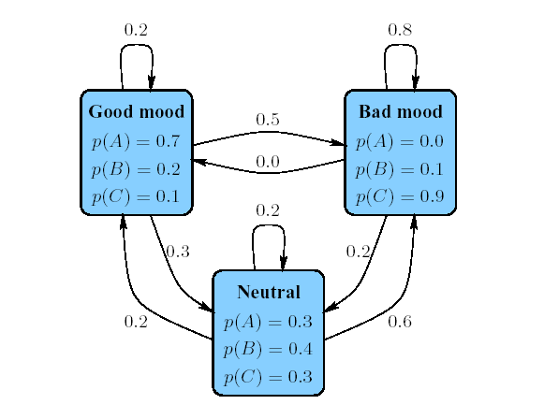

Example: Teacher-mood-model
Model parameters:
Observation $Σ=\{A, B,C\}$
Set of states $S=\{ good, neutral, bad\}$
Transition probabilities between any two states $a_{ij}$
Emission probabilities within each state $b_{i}\left(x\right)$

Slide 57
Example: Teacher-mood-model
One week, your teacher gave the following homework assignments:
Questions
What did his mood curve look like most likely that week?
Searching for the most probable path – Viterbi algorithm
Monday | Tuesday | Wednesday | Thursday | Friday
A | C | B | A | C

Slide 58


HMM: Viterbi algorithm
Given
Hidden Markov model: $S,Σ ,a_{ij} , b_{i}\left(x\right)$
Observed symbol sequence $Q=x_{1}x_{2}…x_{n}$.
Most probable path of states that resulted in symbol sequence $Q$.
Let $V_{t}^{j}$ be the probability of the most probable path of the symbol sequence $x_{1},x_{2},…,x_{t}$ ending in state $j$. Then:
$$V_{t+1}^{j}=b_{j}(x_{t+1})\max_{i}{(V_{t}^{i}a_{ij})}$$

Slide 59



HMM: Viterbi algorithm
Matrix $V_{t}^{j}$, where $j∈S$ and $1≤t≤ n$.
Initialization:
Iteration: $V_{t}^{j}=b_{j}\left(x_{t}\right)\max_{i}{(V_{t−1}^{i}∗a_{ij}})$for all states $i,j∈S,t≥2$.
Algorithm
$$V_{1}^{j}=\frac{b_{j}\left(x_{1}\right)}{\#states}$$
Iteratively build up matrix $V_{t}^{j}$.
Store pointers to chosen path.
Probability of most probable path in maximum entry in last column.
Reconstruct path along pointers.

Slide 60

HMM: Viterbi algorithm
Empty table

Slide 61



HMM: Viterbi algorithm
Initialization: $V_{1}^{j}=b_{j}(x_{1})p(q_{1}=j)$
$$V_{1}^{j}=\frac{b_{j}\left(A\right)}{\#states}$$

Slide 62


HMM: Viterbi algorithm
Initialization: $V_{2}^{j}=b_{j}\left(C\right)\max_{i}{(V_{1}^{i}a_{ij})}$

Slide 63


HMM: Viterbi algorithm
Initialization: $V_{3}^{j}=b_{j}\left(B\right)\max_{i}{(V_{3}^{j}a_{ij})}$

Slide 64

HMM: Viterbi algorithm
Maximum entry in last column

Slide 65

HMM: Viterbi algorithm
Reconstruct path along pointers

Slide 66
HMM: Viterbi algorithm
Question
What did his mood curve look like most likely that week?
Answer
Most probable mood curve:
Day | Monday | Tuesday | Wednesday | Thursday | Friday
Assignment | A | C | B | A | C
Mood | good | bad | neutral | good | bad

Slide 67
Content
Introduction to HMMs: Hidden Markov models
HMM for ASR
Likelihood computation (forward algorithm)
Finding the most probable state sequence (Viterbi algorithm)
Estimating the parameters (forward-backward and EM algorithms)

Slide 68



Training: Baum-Welch algorithm
Goal: Efficiently estimate the parameters of an HMM $λ$ from an observation sequence $X$ and known HMM topology $ℳ$:
Parameters $λ$:
Transition probabilities $a_{ij}=p\left(q_{t+1}=j | q_{t}=i\right)$
Observation probabilities $b_{j}\left(x\right)=p\left(x | q=j\right)$
Maximum likelihood training: find the parameters that maximize
$$F_{ML}\left(λ\right)=\log{p(X|λ)}$$
$$=\sum_{x_{i}∈X}{\log{p(x_{i}|λ)}}$$
$$\max_{λ}{F(λ)}$$
Notes:
Notice that in order for learning to be effective, we need lots of data, i.e., many, long observation histories

Slide 69


Pre-requisite: Maximum likelihood estimation
MLE is a method of estimating the parameters of a statistical model given observations, by finding the parameter values that maximize the likelihood of making the observations given the parameters.
Let D_{c} be the set containing all the samples from class c. Suppose these samples are independent and identically distributed (i.i.d), the likelihood of all the samples belonging to D_{c} given a parameter $θ_{c}$ is:
$$p\left(D_{C} | θ_{c}\right)=\prod_{x_{i}∈D_{c}}{p(x_{i}|θ_{c})}$$

Slide 70



Pre-requisite: Maximum likelihood estimation
We want to maximize $p(D_{C}|θ_{c})$
Log-likelihood ($LL(θ_{c})$) often used instead of using $p(D_{C}|θ_{c})$
The maximum likelihood estimation of $θ_{c}$ is
$$LL\left(θ_{c}\right)=\log{p\left(D_{C} | θ_{c}\right)}$$
$$=\sum_{x_{i}∈D_{c}}{\log{p(x_{i}|θ_{c})}}$$
$${\hat{θ}}_{c}=\arg{\max_{θ_{c}}{LL(θ_{c})}}$$

Slide 71



Pre-requisite: Maximum likelihood estimation
Example:
If the probability density function $p\left(x | c\right)\sim 𝒩(μ_{c},Σ_{c})$, the MLE of $μ_{c}$and $Σ_{c}$is
$${\hat{μ}}_{c}=\frac{1}{\left|D_{c}\right|}\sum_{x_{i}∈D_{c}}{x_{i}}$$
$$Σ_{c}=\frac{1}{\left|D_{c}\right|}\sum_{x_{i}∈D_{c}}{\left(x_{i}−{\hat{μ}}_{c}\right){\left(x_{i}−{\hat{μ}}_{c}\right)}^{T}}$$

Slide 72


Training: Baum-Welch algorithm
Goal: Efficiently estimate the parameters of an HMM $λ$ from an observation sequence $X$ and known HMM topology $ℳ$:
Parameters $λ$:
Transition probabilities $a_{ij}=p\left(q_{t+1}=j | q_{t}=i\right)$
Observation probabilities $b_{j}\left(x\right)=p\left(x | q=j\right)$
Maximum likelihood training: find the parameters that maximize
$$F_{ML}\left(λ\right)=\log{p(X|λ)}$$
$$=\sum_{x_{i}∈X}{\log{p(x_{i}|λ)}}$$
$$=\sum_{x_{i}∈X}{\log{\sum_{Q∈𝒬}{p(x_{i},Q|λ)}}}$$
But likelihood doesn’t factorize since observations not i.i.d.
hidden variables – state sequence $Q=[q_{1},…,q_{T}]$
$$\max_{λ}{F(λ)}$$

Slide 73



Pre-requisite: EM algorithm
If there are latent variables, the set of which is denoted by $Z$, in samples, how to estimate parameters in a generative model?
The objective function
Example:
Given data $x_{1},x_{2},…,x_{m}$ (but no $z_{i}$ observed)
Find maximum likelihood estimates of $μ_{1},μ_{2}$
$$LL\left(θ | X,Z\right)=\ln{P(X,Z|θ)}$$
$$P\left(Z=1\right)=\frac{1}{2},P\left(Z=2\right)=\frac{1}{2}$$
$$X|Z=1\sim 𝒩(μ_{1},1)$$
$$X|Z=2\sim 𝒩(μ_{2},1)$$

Slide 74

Pre-requisite: EM algorithm
EM basic idea: if $Z$ were known $→$ two easy-to-solve separate ML problems
EM iterates over
E-step: For $i=1,…,m$fill in missing data $z_{i}$ according to what is most likely given the current model $μ$
M-step: run ML for completed data, which gives new model $μ$

Slide 75


Pre-requisite: EM algorithm
EM solves a Maximum Likelihood problem of the form
$θ$: parameters of the probabilistic model we try to find
$z$: unobserved variables
$x$: observed variables
$$\max_{θ}{\log{\int_{z}{p\left(z,x;θ\right)dz}}}$$

Slide 76

Pre-requisite: EM algorithm
$$\max_{θ}{\log{\int_{z}{p\left(z,x;θ\right)dz}}}=\max_{θ}{\log{\int_{z}{p\left(z,x;θ\right)\frac{q\left(z\right)}{q\left(z\right)}dz}}}$$
$$=\max_{θ}{\log{\int_{z}{\frac{p\left(z,x;θ\right)}{q\left(z\right)}q\left(z\right)dz}}}$$
$$=\max_{θ}{\log{E_{X\sim q}\left[\frac{p\left(Z,x;θ\right)}{q\left(Z\right)}\right]}}$$
$$≥\max_{θ}{E_{X\sim q}\log\left[\frac{p\left(Z,x;θ\right)}{q\left(Z\right)}\right]}$$
$$=\max_{θ}{\int_{z}{q\left(z\right)\log{p\left(z,x;θ\right)}dz}}$$
$$−\int_{z}{q\left(z\right)\log{q\left(z\right)}dz}$$
Jensen’s Inequality

Slide 77



Pre-requisite: EM algorithm
$$\max_{θ}{\log{\int_{z}{p\left(z,x;θ\right)dz}}}≥\max_{θ}{\int_{z}{q\left(z\right)\log{p\left(z,x;θ\right)}dz}}−\int_{z}{q\left(z\right)\log{q\left(z\right)}dz}$$
Jensen’s Inequality: equality holds when is an affine function
This is achieved for $q\left(z\right)=p(z|x;θ)∝p\left(z,x;θ\right)$
$$f\left(x\right)=\log{\frac{p\left(z,x;θ\right)}{q(z)}}$$
EM Algorithm: Iterate
1. E-step: Compute $q\left(z\right)=p(z|x;θ)$
2. M-step: Compute $θ=\arg{\max_{θ}{\int_{z}{q\left(z\right)\log{p\left(z,x;θ\right)}dz}}}$

Slide 78



EM algorithm in HMM
EM Algorithm:
1. E-step: $q\left(z\right)=p(z|x;θ)$
2. M-step: $θ=\arg{\max_{θ}{\int_{z}{q\left(z\right)\log{p\left(x,z;θ\right)}dx}}}$
If we have some initial parameters $λ_{0}$ and we want to find new parameters to maximize the likelihood $F_{ML}(λ)$, then we can instead maximize
$$\sum_{Q∈𝒬}{p\left(Q | X;λ \right)\log{p(X,Q;λ)}}$$
E-step estimate the state occupation probabilities given the current parameters (Expectation)
M-step re-estimate the HMM parameters based on the estimated state occupation probabilities (Maximization)

Slide 79


EM algorithm in HMM
Application of EM algorithm to HMMs is called Baum-Welch algorithm
E-step – Fix parameters, find states expectation (Forward and Backward algorithm)
M-step – Fix expected states, update parameters
In the initial phase, the content of the parameters $\{a_{ij}\}$ , $\{b_{j}\left(x\right)\}$, $\{a_{0j}\}$ are initialized, and it could be done randomly if there is no prior knowledge about them.
State occupation probability: $γ_{t}^{j}$ is the probability that the system is at state $j$ at time $t$ given the sequence of observations $X$.
We can use this for an iterative algorithm for HMM training
$$γ_{t}^{j}=p\left(q_{t}=j | X;λ\right)=\frac{p\left(q_{t}=j,X\right)}{p\left(X\right)}=\frac{p\left(q_{t}=j,x_{1},…,x_{T}\right)}{p\left(X\right)}$$
Notes:
Maximum likelihood estimation chooses the state with the highest probability at the “best” estimate at each time step
these are pointwise best estimate: the sequence of maximum likelihood estimates is not necessarily a good (or feasible) trajectory for the HMM!

Slide 80


EM algorithm in HMM
Application of EM algorithm to HMMs is called Baum-Welch algorithm
E-step – Fix parameters, find states expectation (Forward and Backward algorithm)
M-step – Fix expected states, update parameters
Remember we have $α_{t}^{j}=p\left(x_{1},x_{2},…,x_{t},q_{t}=j\right)$ (Forward probability)
We need something for the second part: mirror image of the “forward procedure”, called “backward procedure.”
Let $β_{t}^{j}=p(x_{t+1},…,x_{T}|q_{t}=j)$ (Backward probability)
$α_{t}^{j}β_{t}^{j}=p\left(x_{1},…,x_{t},q_{t}=j\right)p\left(x_{t+1},…, x_{T} | q_{t}=j\right)$
$=p(x_{1},…,x_{t},x_{t+1},…,x_{T},q_{t}=j)$
$=p(X,q_{t}=j)$
$$γ_{t}^{j}=p\left(q_{t}=j | X\right)$$
$$=\frac{p({X,q}_{t}=j)}{p\left(X\right)}$$
$$=\frac{α_{t}^{j}β_{t}^{j}}{\sum_{j}^{J}{α_{t}^{j}β_{t}^{j}}}$$
Notes:
The forward and the backward phase form the E-step of the EM algorithm, while the update phase itself is the M-step.

Slide 81

E step: Forward algorithm
Estimate the state occupation probabilities given the current parameters (Expectation)
Determine the likelihood of an observation sequence $X_{t}=(x_{1}, …, x_{t} , …, x_{t})$ being generated by a known HMM topology, $ℳ$.
Compute $α_{t}^{j}$ for all state $j$, time $t$ using dynamic programming:
Initialization $α_{1}^{j}=p\left(x_{1} | q_{1}=j\right)p(q_{1}=j)$
Iteration $α_{t}^{j}=b_{j}(x_{t})\sum_{i=1}^{J}{(α_{t−1}^{i}⋅a_{ij})},1≤j≤J,1≤t≤T$

Slide 82

E step: Backward algorithm
To estimate the state occupation probabilities it is useful to define (recursively) another set of probabilities—the Backward probabilities
$β_{t}^{j}=p\left(x_{t+1},…,x_{T}|q_{t}=j\right)$
Given an HMM, $β_{t}^{j}$is the probability of future observations in state $j$ at time $t$
These can be recursively computed (going backwards in time)
Initialization: $β_{T}^{j}=1 for j=1,…,J$
Recursion
$$β_{t−1}^{j}=\sum_{i=1}^{J}{a_{ji}b_{i}\left(x_{t}\right)β_{t}^{i}} for t=T−1,…,1$$
Termination
$$p\left(X\right)=\sum_{i=1}^{J}{a_{0i}b_{i}\left(x_{1}\right)β_{1}^{i}}$$

Slide 83









E step: Backward algorithm
$$β_{t}^{j}=p(x_{t+1},…,x_{T}|q_{t}=j)=\sum_{i=1}^{J}{a_{ji}b_{j}\left(x_{t+1}\right)β_{t+1}^{i}}$$
t-1
t
t+1
i
i
i
$$a_{ji}$$
$$β_{t+1}^{i}$$
$$∑$$
j
j
$$a_{jj}$$
j
$$β_{t}^{j}$$
$$β_{t+1}^{j}$$
$$a_{jk}$$
k
k
k
$$β_{t+1}^{k}$$

Slide 84


State occupation probability
The state occupation probability $γ_{t}^{j}$ is the probability of the system being state $j$ at time $t$ given the sequence of observations $X$
Express in terms of the forward and backward probabilities:
$$γ_{t}^{j}=p\left(q_{t}=j | X\right)=\frac{α_{t}^{j}β_{t}^{j}}{p\left(X\right)}=\frac{α_{t}^{j}β_{t}^{j}}{\sum_{j=1}^{J}{α_{t}^{j}β_{t}^{j}}}$$

Slide 85


State occupation probability
The state occupation probability $γ_{t}^{j}$ is the probability of the system being state $j$ at time $t$ given the sequence of observations $X$
Express in terms of the forward and backward probabilities:
New concept: how many times is the state trajectory expected to transition from state $j$?
$$γ_{t}^{j}=p\left(q_{t}=j | X\right)=\frac{α_{t}^{j}β_{t}^{j}}{p\left(X\right)}=\frac{α_{t}^{j}β_{t}^{j}}{\sum_{j=1}^{J}{α_{t}^{j}β_{t}^{j}}}$$
$$E\left[\text{\# }\text{of} \text{transitions} \text{from} \text{state} j\right]=\sum_{t=1}^{T−1}{γ_{t}^{j}}$$

Slide 86



M step: Re-estimation of transition probabilities
Similarly to the state occupation probability, we can estimate $ξ_{t}^{\left(i,j\right)}$, the probability of the system in state $i$ at time $t$ and $j$ at $t+1$, given the observations:
New concept: how many times it the state trajectory expected to transition from state $i$ to state $j$?
$$ξ_{t}^{\left(i,j\right)}=p\left(q_{t}=i,q_{t+1}=j | X\right)$$
$$=\frac{p(q_{t}=i,q_{t+1}=j,X)}{p(X)}$$
$$=\frac{α_{t}^{i}a_{ij}b_{j}\left(x_{t+1}\right)β_{t+1}^{j}}{\sum_{j=1}^{J}{α_{t}^{j}β_{t}^{j}}}$$
$$E\left[\text{\# }\text{of} \text{transitions} \text{from} \text{state} i \text{to} \text{state} j\right]=\sum_{t=1}^{T−1}{ξ_{t}^{\left(i,j\right)}}$$

Slide 87



M step: Re-estimation of transition probabilities
We can use this to re-estimate the transition probabilities
Re-estimate the observation probabilities $b_{j}(x)$
$${\hat{a}}_{ij}=\frac{E\left[\text{\# }\text{of} \text{transitions} \text{from} i \text{to} j\right]}{E\left[\text{\# }\text{of} \text{transitions} \text{from} i\right]}=\frac{\sum_{t=1}^{T−1}{ξ_{t}^{\left(i,j\right)}}}{\sum_{t=1}^{T−1}{γ_{t}^{i}}}$$
$${\hat{b}}_{j}\left(x\right)=\frac{E\left[\text{\# }\text{of} \text{times} \text{in} \text{state} j \text{and} \text{the} \text{observation} \text{is} x_{t}\right]}{E\left[\#\text{of} \text{times} \text{in} \text{state} j\right]}$$
$$=\frac{\sum_{t=1}^{T}{γ_{t}^{j}⋅1(x=x_{t})}}{\sum_{t=1}^{T}{γ_{t}^{j}}}$$

Slide 88

Baum-Welch algorithm
Iterative estimation of HMM parameters using the EM algorithm. At each iteration
E step For all time-state pairs
Recursively compute the forward probabilities $α_{t}^{j}$ and backward probabilities $β_{t}^{j}$
Compute the state occupation probabilities $γ_{t}^{j}$ and $ξ_{t}^{(i,j)}$
M step Based on the estimated state occupation probabilities re-estimate the HMM parameters: transition probabilities $a_{ij}$ and parameters of the observation probabilities, $b_{j}(x)$
$a_{ij}=\frac{\sum_{t=1}^{T}{ξ_{t}^{\left(i,j\right)}}}{\sum_{k=1}^{J}{\sum_{t+1}^{T}{ξ_{t}^{(i,k)}}}}$
$b_{j}\left(x\right)=\frac{\sum_{t=1}^{T}{γ_{t}^{j}⋅1(x=x_{t})}}{\sum_{t=1}^{T}{γ_{t}^{j}}}$
The application of the EM algorithm to HMM training is sometimes called the Forward-Backward algorithm or Baum-Welch algorithm

Slide 89


Extension to a corpus of utterances
We usually train from a large corpus of $R$ utterances If $x_{t}^{r}$ is the $t$-th frame of the $r$-th utterance $X^{r}$ then we can compute the probabilities $α_{t}^{jr}$, $β_{t}^{jr}$, $γ_{t}^{jr}$ and $ξ_{t}^{(i,j)r}$ as before
The re-estimates are as before, except we must sum over the $R$ utterances, i.e.
In addition, we usually employ “embedded training”, in which fine tuning of phone labelling with “forced Viterbi alignment” or forced alignment is involved. (For details see Section 9.7 in Jurafsky and Martin's SLP)
$${\hat{a}}_{ij}=\frac{\sum_{r=1}^{R}{\sum_{t=1}^{T}{ξ_{t}^{(i,j)}}}}{\sum_{r=1}^{R}{\sum_{k=1}^{J}{\sum_{t=1}^{T}{ξ_{t}^{(i,k)}}}}}$$

Slide 90
Summary: HMMs
HMMs provide a generative model for statistical speech recognition
Three key problems
Computing the overall likelihood: the Forward algorithm
Decoding the most likely state sequence: the Viterbi algorithm
Estimating the most likely parameters: the EM (Forward-Backward) algorithm
Solutions to these problems are tractable due to the two key HMM assumptions
Conditional independence of observations given the current state
Markov assumption on the states

Slide 91
Assignment 2
Code:
Implement an isolated words recognition program based on HMM
Report:
Describe functions in your program
Discuss the performance of your program, e.g. recognition accuracy, time of training/test, etc.
Discuss the performance of your program when using MFCC features generated by your own codes and by functions provided by the package.

